Slide 1
Testing, and Debugging
Some reflections from TAs in office hours regarding struggling students:
“I feel like they get stuck trying to figure it out by looking at their code instead of trying to get proactive and poke at their code”
“They're checking that their code makes sense; sometimes they can't see the bug until it's being run.”
In lab 2, we talked about how debugging should be a scientific process.
Reading and re-reading your code is very very slow. It’s like trying to chop down a tree with a nail file. Yes, you’ll eventually succeed, but there are much better tools.
Using the debugger (especially with tests!) is incredibly important.
Notes:
This lecture is pretty boring, especially the casting part

Slide 2
Project 1B
Project 1B is out. The goal is to give you some experience with a test-driven workflow, as well as to get some practice with the material from the inheritance1 and inheritance2 lectures.
The programs you write in project 1B are pretty small, so workload shouldn’t be too bad.
The autograder is going to give you almost no details on tests you fail. It’s up to you to write your own tests that are good enough to pass the tests.
We will also test your tests: Make sure to cover interesting corner cases.

Slide 3
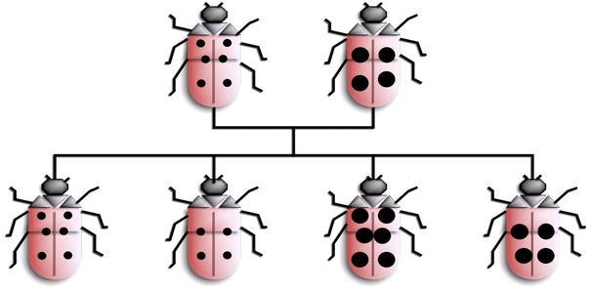
CS61B
Lecture 9: More Inheritance!
Implementation Inheritance: Extends
Encapsulation
Casting
Higher Order Functions in Java

Slide 4
Implementation Inheritance: Extends

Slide 5
The Extends Keyword
When a class is a hyponym of an interface, we used implements.
Example: SLList<Blorp> implements List61B<Blorp>
If you want one class to be a hyponym of another class, you use extends.
We’d like to build RotatingSLList that can perform any SLList operation as well as:
rotateRight(): Moves back item the front.
Example: Suppose we have [5, 9, 15, 22].
After rotateRight: [22, 5, 9, 15]
instead of an interface
List61B
AList
SLList
RotatingSLList

Slide 6
RotatingSLList
public class RotatingSLList<Blorp> extends SLList<Blorp>{
public void rotateRight() {
Blorp oldBack = removeLast();
insertFront(oldBack);
}
}
Because of extends, RotatingSLList inherits all members of SLList:
All instance and static variables.
All methods.
All nested classes.
Constructors are not inherited.
… but members may be private and thus inaccessible! More after midterm.

Slide 7
Another Example: VengefulSLList
Suppose we want to build an SLList that:
Remembers all Items that have been destroyed by removeLast.
Has an additional method printLostItems(), which prints all deleted items.
public static void main(String[] args) {
VengefulSLList<Integer> vs1 = new VengefulSLList<Integer>();
vs1.addLast(1);
vs1.addLast(5);
vs1.addLast(10);
vs1.addLast(13); /* [1, 5, 10, 13] */
vs1.removeLast(); /* 13 gets deleted. */
vs1.removeLast(); /* 10 gets deleted. */
System.out.print("The fallen are: ");
vs1.printLostItems(); /* Should print 10 and 13. */
}

Slide 8
Another Example: VengefulSLList
public class VengefulSLList<Item> extends SLList<Item> {
private SLList<Item> deletedItems;
public VengefulSLList() {
deletedItems = new SLList<Item>();
}
@Override
public Item removeLast() {
Item oldBack = super.removeLast();
deletedItems.addLast(oldBack);
return oldBack;
}
public void printLostItems() {
deletedItems.print();
}
}
calls Superclass’s
version of removeLast()
Note: Java syntax disallows super.super. For a nice description of why, see this link.

Slide 9
Constructor Behavior Is Slightly Weird
Constructors are not inherited. However, the rules of Java say that all constructors must start with a call to one of the super class’s constructors [Link].
Idea: If every VengefulSLList is-an SLList, every VengefulSLList must be set up like an SLList.
If you didn’t call SLList constructor, sentinel would be null. Very bad.
You can explicitly call the constructor with the keyword super (no dot).
If you don’t explicitly call the constructor, Java will automatically do it for you.
public VengefulSLList() {
deletedItems = new SLList<Item>();
}
public VengefulSLList() {
super();
deletedItems = new SLList<Item>();
}
must come first!
These constructors are exactly equivalent.

Slide 10
Calling Other Constructors
If you want to use a super constructor other than the no-argument constructor, can give parameters to super.
public VengefulSLList(Item x) {
super(x);
deletedItems = new SLList<Item>();
}
calls SLList(Item x)
public VengefulSLList(Item x) {
deletedItems = new SLList<Item>();
}
Not equivalent! Code to the right makes implicit call to super(), not super(x).

Slide 11
The Object Class
As it happens, every type in Java is a descendant of the Object class.
VengefulSLList extends SLList.
SLList extends Object (implicitly).
Object
List61B
String
String[]
IntList
Dog
SLList
WorkingDog
ShowDog
VengefulSLList
Documentation for Object class: https://docs.oracle.com/javase/9/docs/api/java/lang/Object.html
SledDog
DrugDog
Interfaces don’t extend Object:
http://docs.oracle.com/javase/specs/jls/se7/html/jls-9.html#jls-9.2

Slide 12
Is-a vs. Has-A
Important Note: extends should only be used for is-a (hypernymic) relationships!
Common mistake is to use it for “has-a” relationships. (a.k.a. meronymic).
Possible to subclass SLList to build a Set, but conceptually weird, e.g. get(i) doesn’t make sense, because sets are not ordered.
SLList
SLList
Set extends SLList
VengefulLSLList extends SLList
printLostItems()
This is an abomination.

Slide 13
Encapsulation

Slide 14
Complexity: The Enemy
When building large programs, our enemy is complexity.
Some tools for managing complexity:
Hierarchical abstraction.
Create layers of abstraction, with clear abstraction barriers!
“Design for change” (D. Parnas)
Organize program around objects.
Let objects decide how things are done.
Hide information others don’t need.
Managing complexity supremely important for large projects (e.g. project 2).

Slide 15
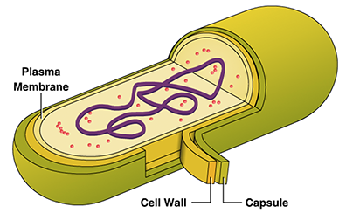
Modules and Encapsulation [Shewchuk]
Module: A set of methods that work together as a whole to perform some task or set of related tasks.
A module is said to be encapsulated if its implementation is completely hidden, and it can be accessed only through a documented interface.
addLast(Item x)
ArrayDeque
removeLast()
size()
...

Slide 16
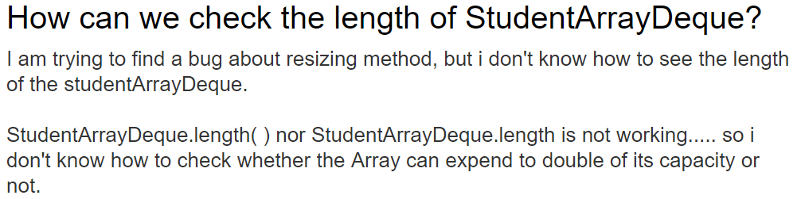
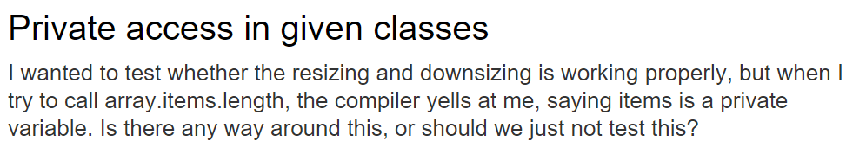
A Cautionary Tale
Interesting Piazza questions from proj1gold from 2016.

Slide 17

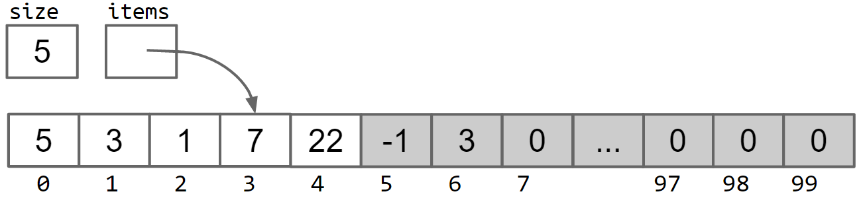
Abstraction Barriers
As the user of an ArrayDeque, you cannot observe its internals.
Even when writing tests, you don’t (usually) want to peer inside.
Java is a great language for enforcing abstraction barriers with syntax.
addLast(Item x)
ArrayDeque
removeLast()
size()
...
{5, 3, 1, 7, 22}
Implementation

Slide 18
Modules and Encapsulation [Shewchuk]
Module: A set of methods that work together as a whole to perform some task or set of related tasks.
A module is said to be encapsulated if its implementation is completely hidden, and it can be accessed only through a documented interface.
Instance variables private. Methods like resize private.
As we’ll see: Implementation inheritance (e.g. extends) breaks encapsulation!
addLast(Item x)
ArrayDeque
removeLast()
size()
...

Slide 19
Implementation Inheritance Breaks Encapsulation
Suppose we have a Dog class with the two methods shown.
public void bark() {
System.out.println("bark");
}
public void barkMany(int N) {
for (int i = 0; i < N; i += 1) {
bark();
}
}
bark()
Dog
barkMany(int N)

Slide 20
Implementation Inheritance Breaks Encapsulation
We could just as easily have implemented methods as shown below.
From the outside, functionality is exactly the same, it’s just a question of aesthetics.
public void bark() {
barkMany(1);
}
public void barkMany(int N) {
for (int i = 0; i < N; i += 1) {
System.out.println("bark");
}
}
bark()
Dog
barkMany(int N)

Slide 21
http://yellkey.com/explain
What would vd.barkMany(3) output?
As a dog, I say: bark bark bark
bark bark bark
Something else.
(assuming vd is a Verbose Dog)
public void bark() {
System.out.println("bark");
}
public void barkMany(int N) {
for (int i = 0; i < N; i += 1) {
bark();
}
}
bark()
Dog
@Override
public void barkMany(int N) {
System.out.println("As a dog, I say: ");
for (int i = 0; i < N; i += 1) {
bark();
}
}
barkMany(int N)
bark()
VerboseDog
calls inherited bark method
barkMany(int N)

Slide 22
Implementation Inheritance Breaks Encapsulation
What would vd.barkMany(3) output?
As a dog, I say: bark bark bark
bark bark bark
Something else.
(assuming vd is a Verbose Dog)
public void bark() {
System.out.println("bark");
}
public void barkMany(int N) {
for (int i = 0; i < N; i += 1) {
bark();
}
}
bark()
Dog
@Override
public void barkMany(int N) {
System.out.println("As a dog, I say: ");
for (int i = 0; i < N; i += 1) {
bark();
}
}
barkMany(int N)
bark()
VerboseDog
calls inherited bark method
barkMany(int N)

Slide 23
http://yellkey.com/without
What would vd.barkMany(3) output?
As a dog, I say: bark bark bark
bark bark bark
Something else.
(assuming vd is a Verbose Dog)
public void bark() {
barkMany(1);
}
public void barkMany(int N) {
for (int i = 0; i < N; i += 1) {
System.out.println("bark");
}
}
bark()
Dog
@Override
public void barkMany(int N) {
System.out.println("As a dog, I say: ");
for (int i = 0; i < N; i += 1) {
bark();
}
}
barkMany(int N)
bark()
VerboseDog
calls inherited bark method
barkMany(int N)

Slide 24
Implementation Inheritance Breaks Encapsulation
What would vd.barkMany(3) output?
c. Something else.
Gets caught in an infinite loop!
(assuming vd is a Verbose Dog)
public void bark() {
barkMany(1);
}
public void barkMany(int N) {
for (int i = 0; i < N; i += 1) {
System.out.println("bark");
}
}
bark()
Dog
@Override
public void barkMany(int N) {
System.out.println("As a dog, I say: ");
for (int i = 0; i < N; i += 1) {
bark();
}
}
barkMany(int N)
bark()
VerboseDog
calls inherited bark method
barkMany(int N)

Slide 25
Type Checking and Casting

Slide 26
Dynamic Method Selection and Type Checking Puzzle
For each line of code, determine:
Does that line cause a compilation error?
Which method does dynamic method selection use?
Static Type
Dynamic Type
public static void main(String[] args) {
VengefulSLList<Integer> vsl =
new VengefulSLList<Integer>(9);
SLList<Integer> sl = vsl;
sl.addLast(50);
sl.removeLast();
sl.printLostItems();
VengefulSLList<Integer> vsl2 = sl;
}
VengefulSLList
vsl
VengefulSLList
VengefulSLList
sl
SLList
SLList
VengefulSLList
Reminder: VengefulSLList overrides removeLast and provides a new method called printLostItems.

Slide 27
Reminder: Dynamic Method Selection
Also called dynamic type.
If overridden, decide which method to call based on run-time type of variable.
sl’s runtime type: VengefulSLList.
public static void main(String[] args) {
VengefulSLList<Integer> vsl =
new VengefulSLList<Integer>(9);
SLList<Integer> sl = vsl;
sl.addLast(50);
sl.removeLast();
}
Static Type
Dynamic Type
VengefulSLList
VengefulSLList doesn’t override, uses SLList’s.
vsl
VengefulSLList
VengefulSLList
sl
SLList
SLList
VengefulSLList
Uses VengefulSLList’s.
Reminder: VengefulSLList overrides removeLast and provides a new method called printLostItems.

Slide 28
Compile-Time Type Checking
Also called static type.
Compiler allows method calls based on compile-time type of variable.
sl’s runtime type: VengefulSLList.
But cannot call printLostItems.
public static void main(String[] args) {
VengefulSLList<Integer> vsl =
new VengefulSLList<Integer>(9);
SLList<Integer> sl = vsl;
sl.addLast(50);
sl.removeLast();
sl.printLostItems();
}
Static Type
Dynamic Type
VengefulSLList
vsl
VengefulSLList
VengefulSLList
sl
SLList
Compilation error!
SLList
VengefulSLList
Reminder: VengefulSLList overrides removeLast and provides a new method called printLostItems.

Slide 29
Compile-Time Type Checking
Also called static type.
Compiler allows method calls based on compile-time type of variable.
sl’s runtime type: VengefulSLList.
But cannot call printLostItems.
public static void main(String[] args) {
VengefulSLList<Integer> vsl =
new VengefulSLList<Integer>(9);
SLList<Integer> sl = vsl;
sl.addLast(50);
sl.removeLast();
sl.printLostItems();
VengefulSLList<Integer> vsl2 = sl;
}
Static Type
Dynamic Type
VengefulSLList
vsl
VengefulSLList
VengefulSLList
sl
SLList
Compilation errors!
SLList
VengefulSLList
Compiler also allows assignments based on compile-time types.
Even though sl’s runtime-type is VengefulSLList, cannot assign to vsl2.
Compiler plays it as safe as possible with type checking.

Slide 30
Compile-Time Types and Expressions
Expressions have compile-time types:
An expression using the new keyword has the specified compile-time type.
Compile-time type of right hand side (RHS) expression is VengefulSLList.
A VengefulSLList is-an SLList, so assignment is allowed.
Compile-time type of RHS expression is SLList.
An SLList is not necessarily a VengefulSLList, so compilation error results.
SLList<Integer> sl = new VengefulSLList<Integer>();
VengefulSLList<Integer> vsl = new SLList<Integer>();
Compilation error!

Slide 31
Compile-Time Types and Expressions
Expressions have compile-time types:
Method calls have compile-time type equal to their declared type.
Any call to maxDog will have compile-time type Dog!
public static Dog maxDog(Dog d1, Dog d2) { … }
Example:
Poodle frank = new Poodle("Frank", 5);
Poodle frankJr = new Poodle("Frank Jr.", 15);
Dog largerDog = maxDog(frank, frankJr);
Poodle largerPoodle = maxDog(frank, frankJr);
Compilation error!
RHS has compile-time type Dog.

Slide 32
Casting
Java has a special syntax for specifying the compile-time type of any expression.
Put desired type in parenthesis before the expression.
Examples:
Compile-time type Dog:
Compile-time type Poodle:
Tells compiler to pretend it sees a particular type.
maxDog(frank, frankJr);
(Poodle) maxDog(frank, frankJr);
Compilation OK!
RHS has compile-time type Poodle.
Poodle frank = new Poodle("Frank", 5);
Poodle frankJr = new Poodle("Frank Jr.", 15);
Dog largerDog = maxDog(frank, frankJr);
Poodle largerPoodle = (Poodle) maxDog(frank, frankJr);

Slide 33
Casting
Casting is a powerful but dangerous tool.
Tells Java to treat an expression as having a different compile-time type.
In example below, effectively tells the compiler to ignore its type checking duties.
Does not actually change anything: sunglasses don’t make the world dark.
If we run the code above, we get a ClassCastException at runtime.
So much for .class files being verifiably type checked...
Poodle frank = new Poodle("Frank", 5);
Malamute frankSr = new Malamute("Frank Sr.", 100);
Poodle largerPoodle = (Poodle) maxDog(frank, frankSr);

Slide 34
Dynamic Method Selection and Casting Puzzle

Slide 35
Is it Overriding? Overloading?
public class Bird {
public void gulgate(Bird b) {
System.out.println("BiGulBi"); }}
public class Falcon extends Bird {
public void gulgate(Falcon f) {
System.out.println("FaGulFa");}}
What gets printed?
BiGulBi BiGulBi
BiGulBi FaGulFa
FaGulFa BiGulBi
FaGulFa FaGulFa
Bird bird = new Falcon();
Falcon falcon = (Falcon) bird;
bird.gulgate(falcon);
falcon.gulgate(falcon);

Slide 36
Is it Overriding? Overloading?
public class Bird {
public void gulgate(Bird b) {
System.out.println("BiGulBi"); }}
public class Falcon extends Bird {
public void gulgate(Falcon f) {
System.out.println("FaGulFa");}}
Casting causes no change to the bird variable, nor to the object the bird variable points at!
What gets printed?
b. BiGulBi FaGulFa
Bird bird = new Falcon();
Falcon falcon = (Falcon) bird;
bird.gulgate(falcon);
falcon.gulgate(falcon);

Slide 37
Why does BiGulBi get printed first?
public class Bird {
public void gulgate(Bird b) {
System.out.println("BiGulBi"); }}
public class Falcon extends Bird {
public void gulgate(Falcon f) {
System.out.println("FaGulFa");}}
Bird bird = new Falcon();
Falcon falcon = (Falcon) bird;
bird.gulgate(falcon);
Remember: The compiler chooses the most specific matching method signature from the static type of the invoking class.
Falcon is overloading the gulgate method, not overriding.
Compiler basically thinks “does Bird class have a gulgate method? Yes! I’ll use that”. Since there is no overloading, no dynamic method selection occurs.

Slide 38
Higher Order Functions
(A First Look)

Slide 39
Higher Order Functions
Higher Order Function: A function that treats another function as data.
e.g. takes a function as input.
Example in Python:
def tenX(x):
return 10*x
def do_twice(f, x):
return f(f(x))
print(do_twice(tenX, 2))
200

Slide 40
Higher Order Functions in Java 7
Old School (Java 7 and earlier)
Fundamental issue: Memory boxes (variables) cannot contain pointers to functions.
Can use an interface instead. Let’s try it out.
IntUnaryFunction
def tenX(x):
return 10*x
def do_twice(f, x):
return f(f(x))
print(do_twice(tenX, 2))
apply(int)
TenX
apply(int)

Slide 41
Higher Order Functions in Java 7
Old School (Java 7 and earlier)
Fundamental issue: Memory boxes (variables) cannot contain pointers to functions.
Can use an interface instead: Java code below is equivalent to given python code.
public interface IntUnaryFunction {
int apply(int x);
}
def tenX(x):
return 10*x
public class TenX implements IntUnaryFunction {
public int apply(int x) {
return 10 * x;
}
}

Slide 42
Example: Higher Order Functions Using Interfaces in Java
public interface IntUnaryFunction {
int apply(int x);
}
def tenX(x):
return 10*x
def do_twice(f, x):
return f(f(x))
print(do_twice(tenX, 2))
public class TenX implements IntUnaryFunction {
public int apply(int x) {
return 10 * x;
}
}
public class HoFDemo {
public static int do_twice(IntUnaryFunction f, int x) {
return f.apply(f.apply(x));
}
public static void main(String[] args) {
System.out.println(do_twice(new TenX(), 2));
}
}

Slide 43
Example: Higher Order Functions in Java 8 or Later
In Java 8, new types were introduced: now can can hold references to methods.
You’re welcome to use these features, but we won’t teach them.
Why? The old way is still widely used, e.g. Comparators (see next lecture).
public class Java8HoFDemo {
public static int tenX(int x) {
return 10*x;
}
public static int doTwice(Function<Integer, Integer> f, int x) {
return f.apply(f.apply(x));
}
public static void main(String[] args) {
int result = doTwice(Java8HoFDemo::tenX, 2);
System.out.println(result);
}
}

Slide 44
Implementation Inheritance Cheatsheet
VengefulSLList extends SLList means a VenglefulSLList is-an SLList. Inherits all members!
Variables, methods, nested classes.
Not constructors.
Subclass constructor must invoke superclass constructor first.
Use super to invoke overridden superclass methods and constructors.
Invocation of overridden methods follows two simple rules:
Compiler plays it safe and only lets us do things allowed by static type.
Compiler chooses 2
For overridden methods the actual method invoked is based on dynamic type of invoking expression, e.g. Dog.maxDog(d1, d2).bark();
Can use casting to overrule compiler type checking.
Does not apply to overloaded methods!

Slide 45
Extra Problem Just For Fun

Slide 46
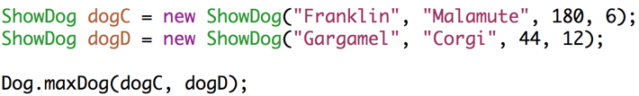

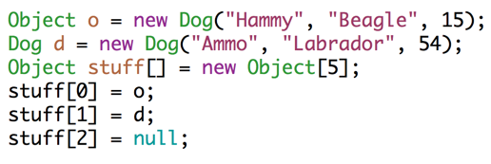
Type Checking Quiz!
1. What is the static type of Dog.maxDog(dogC, dog D)?
2. Which (if any), will compile:
3. How many memory boxes are there in the code below? What are the dynamic types of their contents?

Slide 47
Citations
https://wikids-life.wikispaces.com/file/view/LadybirdInheritance.jpg/160451153/604x297/LadybirdInheritance.jpg

Slide 48
Actual truth:
size
items
5
5
3
1
7
22
-1
3
0
...
0
0
0
0 1 2 3 4 5 6 7 97 98 99

